Slide 1
Module 5: Lesson 3 Transformations – Join

Slide 2
Join
The function returns a new target DataFrame which is the join of two source DataFrames based on a join expression and join type (inner, outer, etc.)
DataFrame.join(other, on=None, how=None)→ DataFrame
other is a source DataFrame (the right side of the join)
on is the join expression (left_df_column operator right_df_column)
how indicates the join type: inner, outer, left_outer, right_outer, etc.
operator:
equi-join: ==
comparative join (generally not recommended): <, >, <=, >=

Slide 3
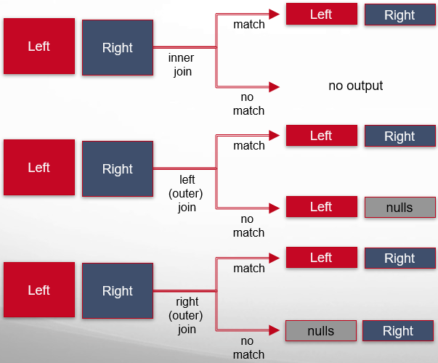
Join
joinExpression = leftDF[‘l_id’] == rightDF[‘r_id’]
joinedDF = leftDF.join(rightDF, joinExpression, joinType)
joinType = ‘inner’
joinType = ‘left_outer’
joinType = ‘right_outer’

Slide 4
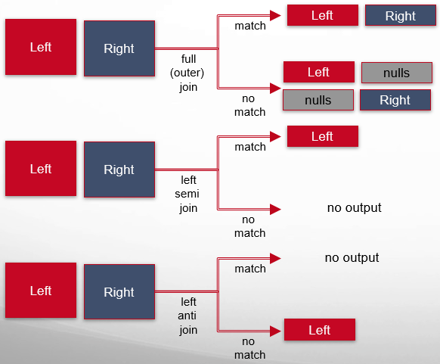
Join
joinExpression = leftDF[‘l_id’] == rightDF[‘r_id’]
joinedDF = leftDF.join(rightDF, joinExpression, joinType)
joinType = ‘outer’
joinType = ‘left_semi’
joinType = ‘left_anti’

Slide 5
Using an Inner Join
joinType = ‘inner’
joinExpression = leftDF[‘cylinders’] == rightDF[‘cyl-count’]
targetDF = leftDF.join(rightDF, joinExpression, joinType)
+----+---------+----------+---------+--------------------+
| mpg|cylinders|horsepower|modelyear| carname|
+----+---------+----------+---------+--------------------+
|29.0| 4| 49.00| 73| fiat 128|
|32.0| 4| 61.00| 74| datsun 710|
|19.8| 6| 85.00| 79| mercury zephyr 6|
|44.3| 4| 48.00| 80|vw rabbit c (diesel)|
|36.4| 5| 67.00| 80| audi 5000s (diesel)|
|31.6| 4| 74.00| 81| mazda 626|
+----+---------+----------+---------+--------------------+
+---------+-----------+
|cyl-count|engine-name|
+---------+-----------+
| 8| v8|
| 6| v6|
| 5| v5|
| 4| v4|
+---------+-----------+
leftDF
rightDF
+----+---------+----------+---------+--------------------+---------+-----------+
| mpg|cylinders|horsepower|modelyear| carname|cyl-count|engine-name|
+----+---------+----------+---------+--------------------+---------+-----------+
|29.0| 4| 49.00| 73| fiat 128| 4| v4|
|32.0| 4| 61.00| 74| datsun 710| 4| v4|
|19.8| 6| 85.00| 79| mercury zephyr 6| 6| v6|
|44.3| 4| 48.00| 80|vw rabbit c (diesel)| 4| v4|
|36.4| 5| 67.00| 80| audi 5000s (diesel)| 5| v5|
|31.6| 4| 74.00| 81| mazda 626| 4| v4|
+----+---------+----------+---------+--------------------+---------+-----------+
Both join columns are included in the final join DataFrame
targeDF

Slide 6
Using an Outer Join
joinType = ‘outer’
joinExpression = leftDF[‘cylinders’] == rightDF[‘cyl-count’]
targetDF = leftDF.join(rightDF, joinExpression, joinType)
+----+---------+----------+---------+--------------------+
| mpg|cylinders|horsepower|modelyear| carname|
+----+---------+----------+---------+--------------------+
|29.0| 4| 49.00| 73| fiat 128|
|32.0| 4| 61.00| 74| datsun 710|
|19.8| 6| 85.00| 79| mercury zephyr 6|
|44.3| 4| 48.00| 80|vw rabbit c (diesel)|
|36.4| 5| 67.00| 80| audi 5000s (diesel)|
|31.6| 4| 74.00| 81| mazda 626|
+----+---------+----------+---------+--------------------+
+---------+-----------+
|cyl-count|engine-name|
+---------+-----------+
| 8| v8|
| 6| v6|
| 5| v5|
| 4| v4|
+---------+-----------+
leftDF
rightDF
+----+---------+----------+---------+--------------------+---------+-----------+
| mpg|cylinders|horsepower|modelyear| carname|cyl-count|engine-name|
+----+---------+----------+---------+--------------------+---------+-----------+
|29.0| 4| 49.00| 73| fiat 128| 4| v4|
|32.0| 4| 61.00| 74| datsun 710| 4| v4|
|44.3| 4| 48.00| 80|vw rabbit c (diesel)| 4| v4|
|31.6| 4| 74.00| 81| mazda 626| 4| v4|
|36.4| 5| 67.00| 80| audi 5000s (diesel)| 5| v5|
|19.8| 6| 85.00| 79| mercury zephyr 6| 6| v6|
|NULL| NULL| NULL| NULL| NULL| 8| v8|
+----+---------+----------+---------+--------------------+---------+-----------+
Both join columns are included in the final join DataFrame
targeDF

Slide 7
What if Two Columns Have the Same Name?
The two join keys have the same names:
joinType = ‘inner’
joinExpression = leftDF[‘someName’] == rightDF[‘someName’]
targetDF = leftDF.join(rightDF, joinExpression, joinType)
Or two non-join columns have the same name
This makes it difficult to refer to a specific column when the target DataFrame (after a join operation) has duplicate column names

Slide 8
What if Two Columns Have the Same Name?
joinType = ‘inner’
joinExpression = leftDF[‘cylinders’] == rightDF[‘cylinders’]
targetDF = leftDF.join(rightDF, joinExpression, joinType)
+----+---------+----------+---------+--------------------+
| mpg|cylinders|horsepower|modelyear| carname|
+----+---------+----------+---------+--------------------+
|29.0| 4| 49.00| 73| fiat 128|
|32.0| 4| 61.00| 74| datsun 710|
|19.8| 6| 85.00| 79| mercury zephyr 6|
|44.3| 4| 48.00| 80|vw rabbit c (diesel)|
|36.4| 5| 67.00| 80| audi 5000s (diesel)|
|31.6| 4| 74.00| 81| mazda 626|
+----+---------+----------+---------+--------------------+
+---------+-----------+
|cylinders|engine-name|
+---------+-----------+
| 8| v8|
| 6| v6|
| 5| v5|
| 4| v4|
+---------+-----------+
leftDF
rightDF
+----+---------+----------+---------+--------------------+---------+-----------+
| mpg|cylinders|horsepower|modelyear| carname|cylinders|engine-name|
+----+---------+----------+---------+--------------------+---------+-----------+
|29.0| 4| 49.00| 73| fiat 128| 4| v4|
|32.0| 4| 61.00| 74| datsun 710| 4| v4|
|19.8| 6| 85.00| 79| mercury zephyr 6| 6| v6|
|44.3| 4| 48.00| 80|vw rabbit c (diesel)| 4| v4|
|36.4| 5| 67.00| 80| audi 5000s (diesel)| 5| v5|
|31.6| 4| 74.00| 81| mazda 626| 4| v4|
+----+---------+----------+---------+--------------------+---------+-----------+
Two join columns have the same name
targeDF

Slide 9
Approaches for Handling Duplicate Column Names
Rename a column before the join:
newRIghtDF = rightDF.withColumnRenamed(‘oldName’, ‘newName’)
Drop the Column after a join:
targetDF = leftDF.join(rightDF, joinExpression, joinType)
target2DF = targetDF.drop(leftDF[‘dupName’])
Use a join expression which automatically removes one of the duplicate columns:
targetDF = leftDF.join(rightDF, ‘dupName’, joinType)

Slide 10
What if Two Columns Have the Same Name?
joinType = ‘inner’
joinExpression = ‘cylinders’
targetDF = leftDF.join(rightDF, joinExpression, joinType)
+----+---------+----------+---------+--------------------+
| mpg|cylinders|horsepower|modelyear| carname|
+----+---------+----------+---------+--------------------+
|29.0| 4| 49.00| 73| fiat 128|
|32.0| 4| 61.00| 74| datsun 710|
|19.8| 6| 85.00| 79| mercury zephyr 6|
|44.3| 4| 48.00| 80|vw rabbit c (diesel)|
|36.4| 5| 67.00| 80| audi 5000s (diesel)|
|31.6| 4| 74.00| 81| mazda 626|
+----+---------+----------+---------+--------------------+
+---------+-----------+
|cylinders|engine-name|
+---------+-----------+
| 8| v8|
| 6| v6|
| 5| v5|
| 4| v4|
+---------+-----------+
leftDF
rightDF
+---------+----+----------+---------+--------------------+-----------+
|cylinders| mpg|horsepower|modelyear| carname|engine-name|
+---------+----+----------+---------+--------------------+-----------+
| 4|29.0| 49.00| 73| fiat 128| v4|
| 4|32.0| 61.00| 74| datsun 710| v4|
| 6|19.8| 85.00| 79| mercury zephyr 6| v6|
| 4|44.3| 48.00| 80|vw rabbit c (diesel)| v4|
| 5|36.4| 67.00| 80| audi 5000s (diesel)| v5|
| 4|31.6| 74.00| 81| mazda 626| v4|
+---------+----+----------+---------+--------------------+-----------+
targeDF

